Slide 1
Low-Resolution Image Classification- Review 2
Minor Project (INS Valsura Contd.)
By- Devasy(20BCE057), Deep(20BCE200)

Slide 2
Index
Introductory brief about where we picked it up.
Goals and milestones defined.
Image preprocessing pipelines.
Impact of Grid search to train ensemble model.
Additional tasks and contribution.
Workflows
Deep Learning Models
Conclusion and future scope.

Slide 3
Introduction
Initial Approach - used a Traditional Machine Learning Algorithm for the classification.
Deployment - deployed the model using the Streamlit library, making it accessible and user-friendly.
Performance - Traditional Machine Learning Algorithm gave a baseline of 81% Accuracy
Limitation - there were some amount of false positives and the system was not scalable.

Slide 4
Goals
Develop a complete user friendly software for classification.
Improve the accuracy of the model.
To increase the performance of model by leveraging techniques like:
Image Preprocessing
Deep Learning
Ensemble model
Transfer Learning

Slide 5
5 Classes
Cargo
Container
Fishing Vessel
Island
Tanker

Slide 6

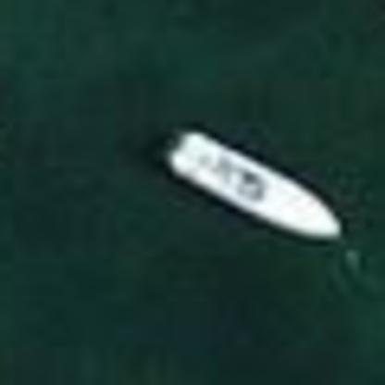
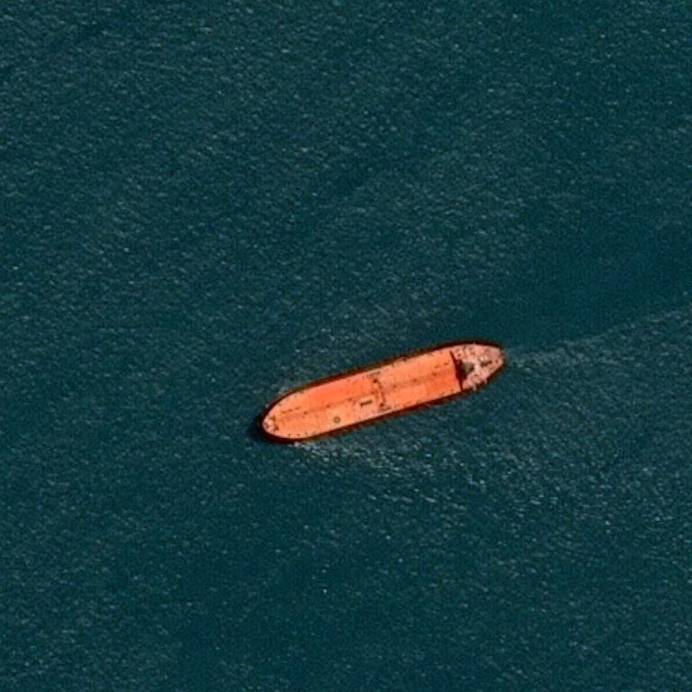
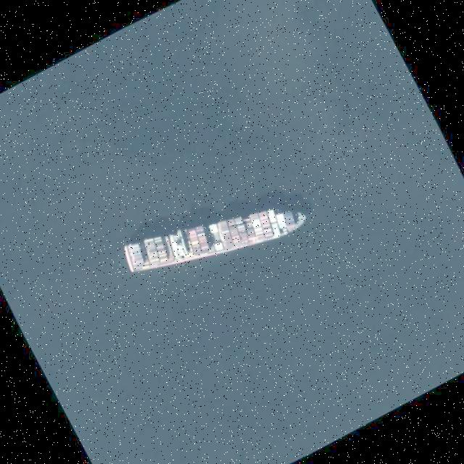
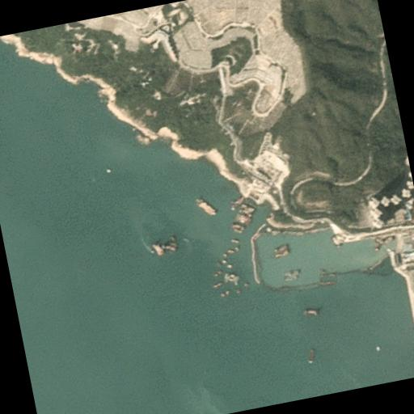
Some of the Images
Cargo
Fishing Vessel
Tanker
Container
Island

Slide 7
Image Preprocessing
Image Preprocessing plays a crucial role in enhancing the accuracy of our ship classification model.
We applied three techniques: Laplacian Filters, Sobel Mask and Histogram equalization
Laplacian Filters: used to detect edges and features within images.
Sobel Masks: used for gradient computation and edge highlighting, aiding in the extraction of essential features and shapes.
Histogram Equalization: used to improve the contrast and visual quality of images.

Slide 8
Advantages
Improved Feature Extraction: Enhanced images make it easier for the model to extract relevant features.
Noise Reduction: Preprocessing helps reduce noise in the input data, leading to a cleaner signal.
Data Standardization: Preprocessing techniques ensure a consistent format and quality for input data, minimizing variations in image characteristics.
Enhanced Classification: By making images more distinct, preprocessing contributes to more accurate ship classification.
Reduced False Positives: By reducing noise and enhancing features, preprocessing can help minimize false positive classifications that may occur in challenging conditions

Slide 9
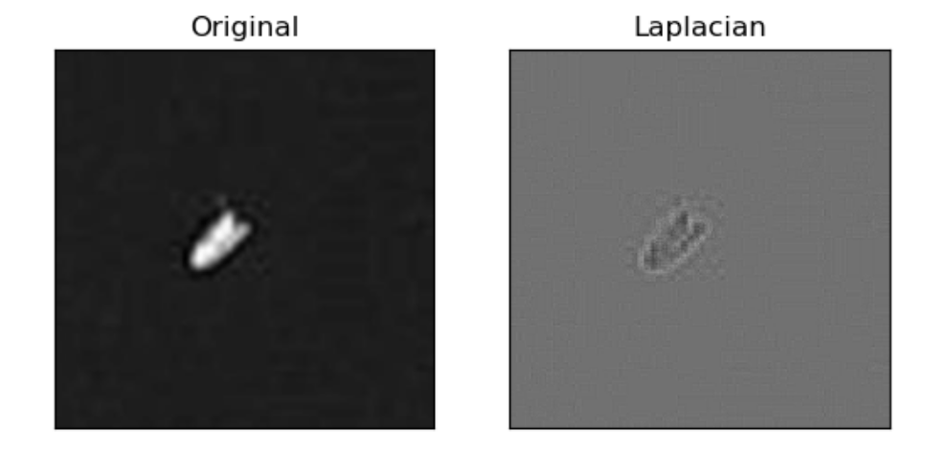
Results

Slide 10
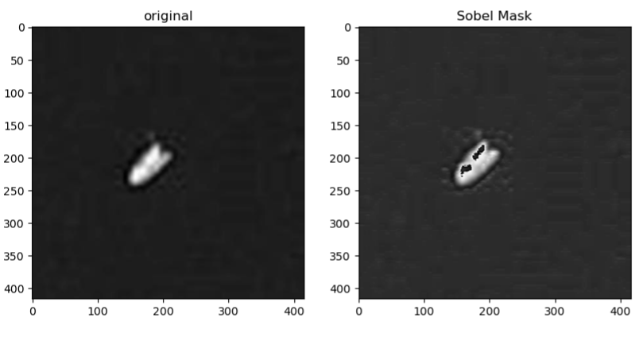

Slide 11
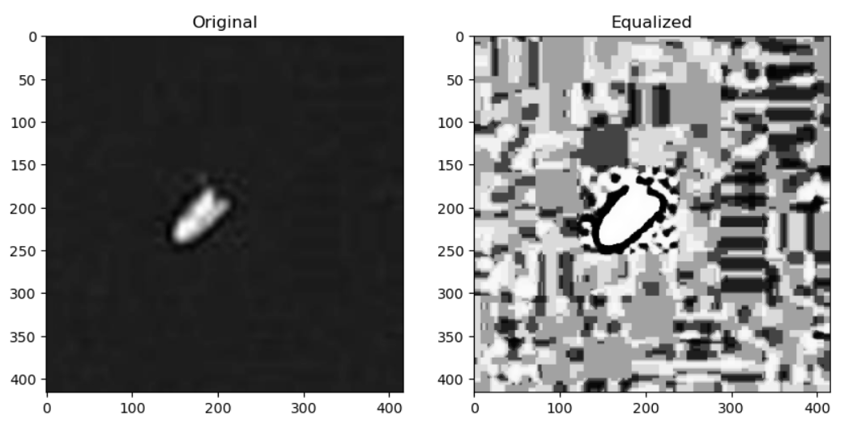

Slide 12
Introduction and Model Diversity
Introduction:
Utilizing grid search to fine-tune ensemble models.
Focus on Laplacian and Sobel filters with ExtraTrees, SVM, and XGBoost.
Enabling Model Diversity:
Grid search allowed us to systematically optimize the hyperparameters of each model, generating a wide range of models with various settings.
We aimed to increase the diversity of our ensemble, which is critical for enhancing overall model performance.

Slide 13
Comprehensive Experimentation and Model Selection
Comprehensive Experimentation:
We performed a total of 24 experiments, testing six Laplacian derivative filters (Laplacian1 to Laplacian6) and two Sobel filters (Sobel1 and Sobel2) in conjunction with three machine learning models (ExtraTrees, SVM, and XGBoost).
The grid search process aimed to identify the optimal hyperparameters for each combination.
Model Selection:
After training, we evaluated the models' performance using accuracy metrics.
The top-performing models (the top 5) were chosen based on their accuracy, ensuring that only the most effective models contributed to the ensemble.
XBG Performed significantly well along with laplacian variations 5 and 6.

Slide 14
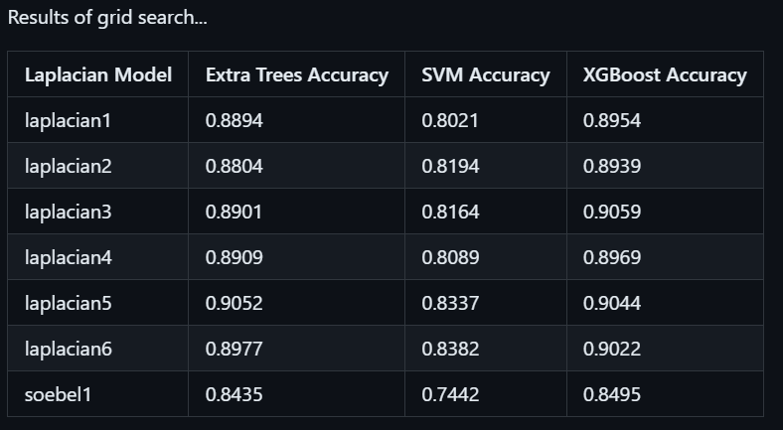
Results of Grid Search

Slide 15
Impact on Accuracy, Practical Applications, and Conclusion
Impact on Accuracy:
Grid search, coupled with ensemble modeling, significantly enhanced our model's accuracy.
The final ensemble classifier incorporated the most accurate models from the extensive experimentation, resulting in improved predictive power.
Conclusion:
The impact of grid search on training ensemble models is evident in the significant improvement in accuracy achieved through a systematic exploration of hyperparameters.
Our project serves as a testament to the potential of grid search in enhancing machine learning models and paves the way for further research and applications in this field.

Slide 16
Additional Tasks and Contributions
Implementing GitHub Workflows:
We extended our project's capabilities by implementing GitHub workflows.
A custom workflow was designed to automatically trigger the grid search process upon detecting a commit message containing "grid-search-begin."
This streamlined the hyperparameter optimization process and opened a pull request with the newly saved model.
Workflow automation improved efficiency and ensured the latest model was readily available for evaluation.

Slide 17
Autoencoder Decoder Architecture:
In pursuit of higher accuracy, we introduced an autoencoder decoder architecture.
This innovative approach significantly improved our model's accuracy, achieving an outstanding score of 0.9807.
The classification report highlights exceptional precision, recall, and F1-score values, making our model highly reliable for various applications.
The confusion matrix further illustrates the model's superior performance across multiple classes.

Slide 18
Conclusion
In our presentation, we embarked on a journey from inception to execution, providing an introductory brief about our project's origins.
We set clear goals and milestones, which acted as guiding stars throughout our project.
We delved into the intricacies of image preprocessing pipelines, emphasizing the significance of data preparation in machine learning tasks.
The impact of grid search on training ensemble models was evident as we systematically optimized hyperparameters for a diverse set of models, leading to improved predictive accuracy.
Additional tasks and contributions were a testament to our dedication to pushing the boundaries of machine learning.
From implementing GitHub workflows for automation to introducing an autoencoder decoder architecture that achieved remarkable accuracy, our project demonstrated innovation and excellence.

Slide 19
Thankyou

